Slide 1
Statistics 367-1-4361 Linear Models
Opher Donchin

Slide 2
6A Review

Slide 3

Time for Kahoot Quiz!
Notes:
Get ready to test your knowledge with a fun and interactive Kahoot quiz. This quiz will challenge your understanding of the topics we've covered and provide an engaging way to review the material. Make sure to have your devices ready and join the game using the provided pin. Let's see who the top scorer will be!

Slide 4
6B Bivariate data

Slide 5
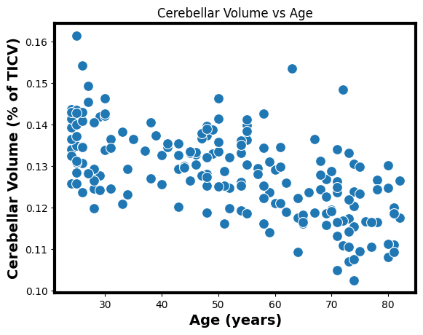
Some bivariate data
x: independent variable
y: dependent variable
Sometimes this makes sense
Age is affecting cerebellar volume
Sometimes it’s arbitrary
Cerebral volume and cerebellar volume

Slide 6
Examples of bivariate data
May be linearly related
Probably not linearly related
Age and number of wrinkles
Age and back pain between 35 and 45
Hours studied and grade

Slide 7
The bivariate population model
Like the normal model
Where the mean depends on another variable

Slide 8
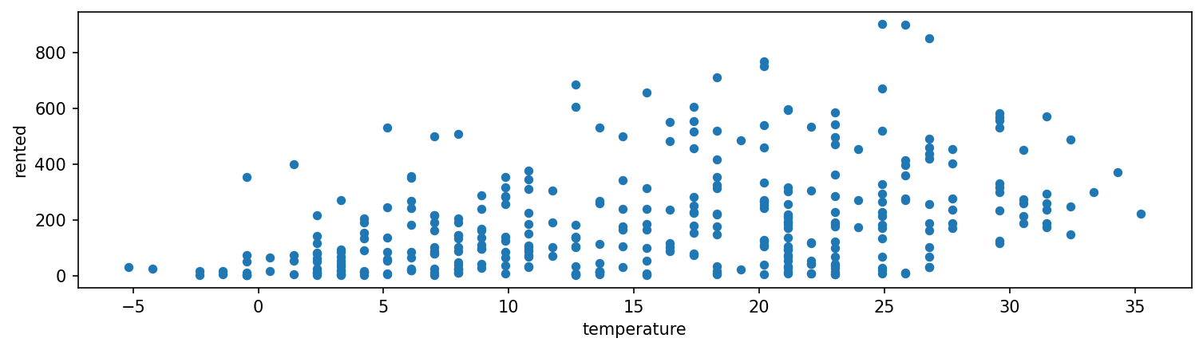
Bike rentals and temperature
Fewer people want to rent bikes when it is below freezing!
Which assumptions hold?

Slide 9
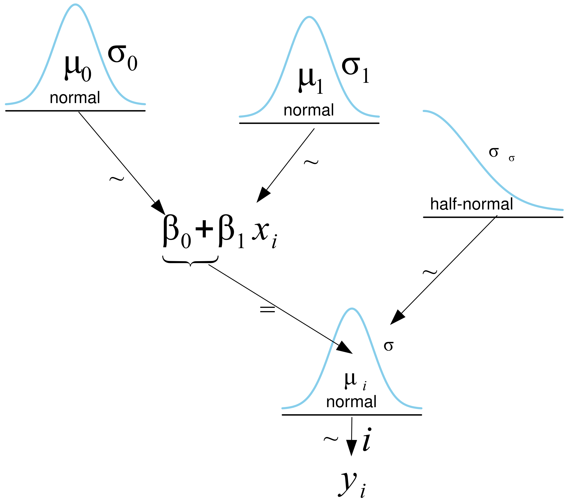
Modeling the bike data
coords = {"data": np.arange(len(bikes))}
with pm.Model(coords=coords) as model_lb:
β0 = pm.Normal("β0", mu=0, sigma=100)
β1 = pm.Normal("β1", mu=0, sigma=10)
σ = pm.HalfNormal("σ", 10)
μ = pm.Deterministic("μ", β0 + β1 * bikes.temperature, dims="data")
y_pred = pm.Normal("y_pred", mu=μ, sigma=σ, observed=bikes.rented, dims="data")
)
Using a deterministic variable

Slide 10
Deterministic variables in PyMC
Deterministic variables
Get a new value at each MCMC sample
Can have both inputs and outputs
Are in the PyTensor graph
Are sampled in the posterior of the InferenceData object
This is what declaring the variable does
With a declared deterministic variable
μ = pm.Deterministic("μ", β0 + β1 * bikes.temperature)
y_pred = pm.Normal("y_pred", mu=μ, sigma=σ, observed=bikes.rented)
Without a declared deterministic variable
μ = β0 + β1 * bikes.temperature
y_pred = pm.Normal("y_pred", mu=μ, sigma=σ, observed=bikes.rented)

Slide 11
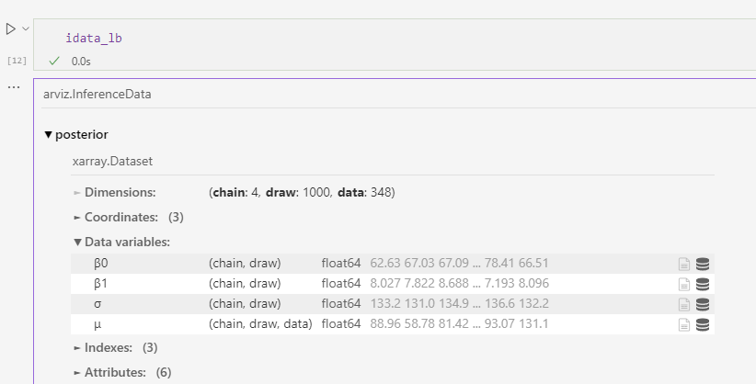
The deterministic variable in the idata
This can be a large object
Which can be recalculated if necessary

Slide 12
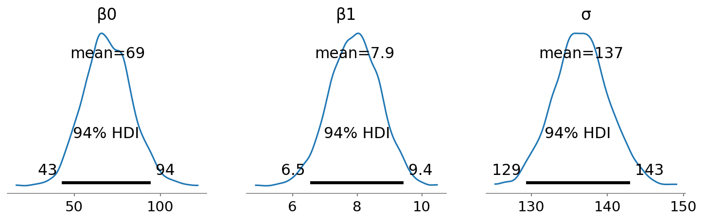
Posteriors are distributions
But also:
This is a prediction about the number of bikes rented at each temperature
That includes uncertainty

Slide 13
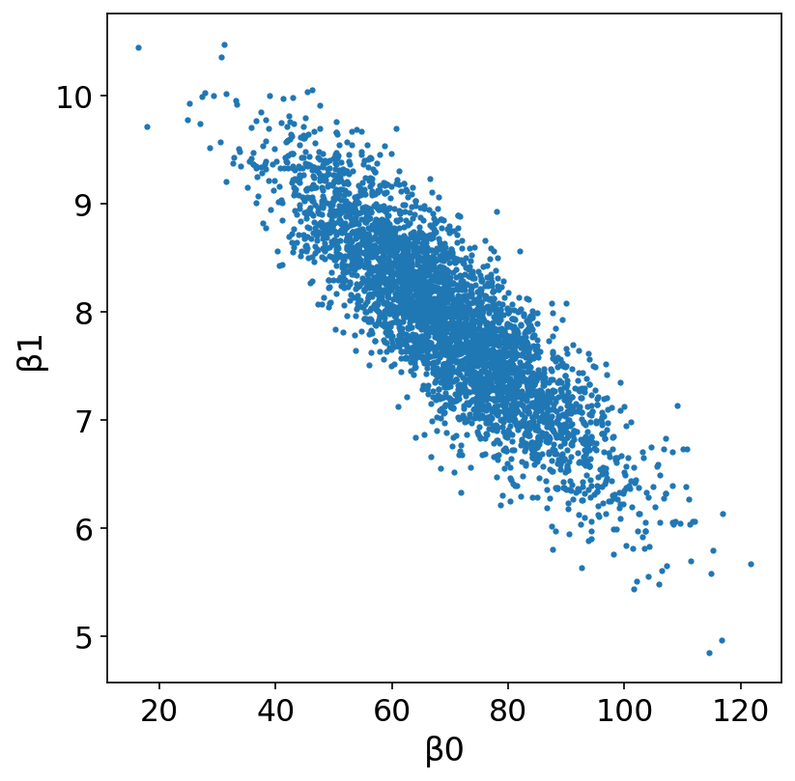
Joint distribution figure
az.plot_pair(idata_lb, var_names=["β0", "β1"], kind="scatter"
Samples are from the joint distribution
Parameters may be correlated
Pair plots show these relationships

Slide 14
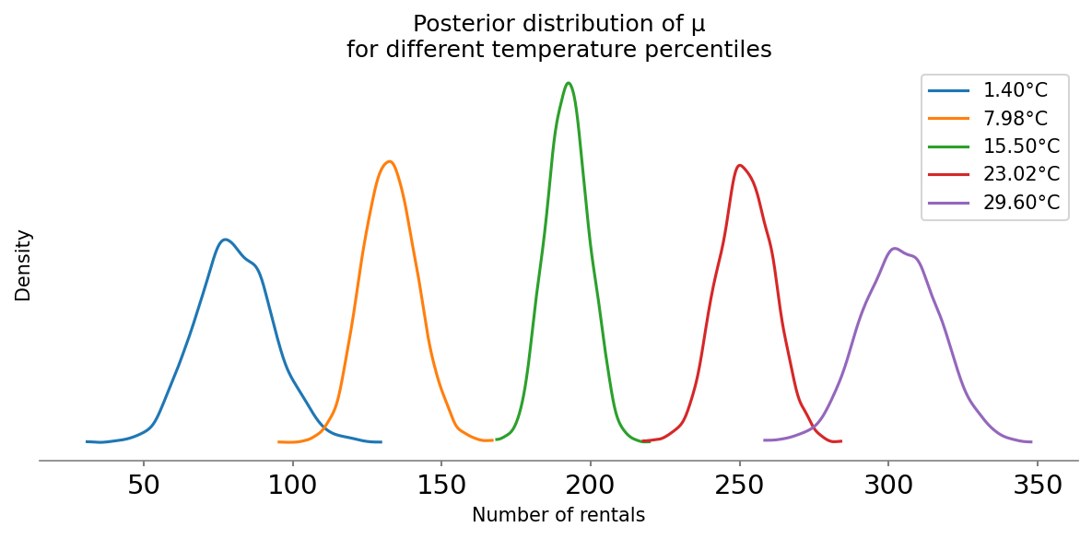
Picture of distribution of mus for different x
The regression line
MCMC samples for the regression line
Calculated from MCMC samples
of the parameters

Slide 15
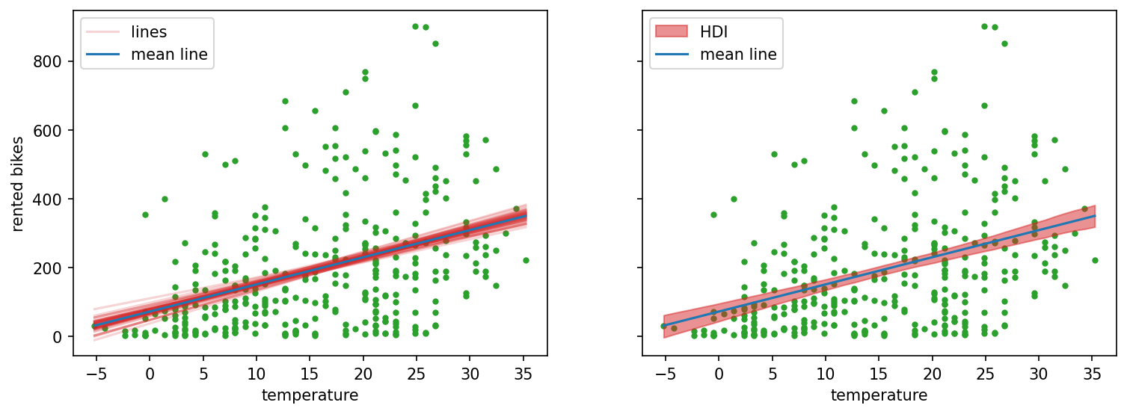
Showing the uncertainty
Using multiple samples from the posterior
Each red line is an MCMC sample
Mean line:
Lines:

Slide 16
Showing the uncertainty
Using multiple samples from the posterior
Each red line is an MCMC sample
posterior = az.extract(idata_lb, num_samples=50)
x_plot = xr.DataArray(
np.linspace(
bikes.temperature.min(), bikes.temperature.max(), 50),
dims="plot_id"
)
mean_line = posterior["β0"].mean() + posterior["β1"].mean() * x_plot
lines = posterior["β0"] + posterior["β1"] * x_plot

Slide 17
Showing the uncertainty
Using multiple samples from the posterior
It can all be calculated from the idata object
posterior = az.extract(idata_lb, num_samples=50)
x_plot = xr.DataArray(
np.linspace(
bikes.temperature.min(), bikes.temperature.max(), 50),
dims="plot_id"
)
mean_line = posterior["β0"].mean() + posterior["β1"].mean() * x_plot
lines = posterior["β0"] + posterior["β1"] * x_plot
Get 50 samples
Create x values with the right dimensions
Create the lines

Slide 18
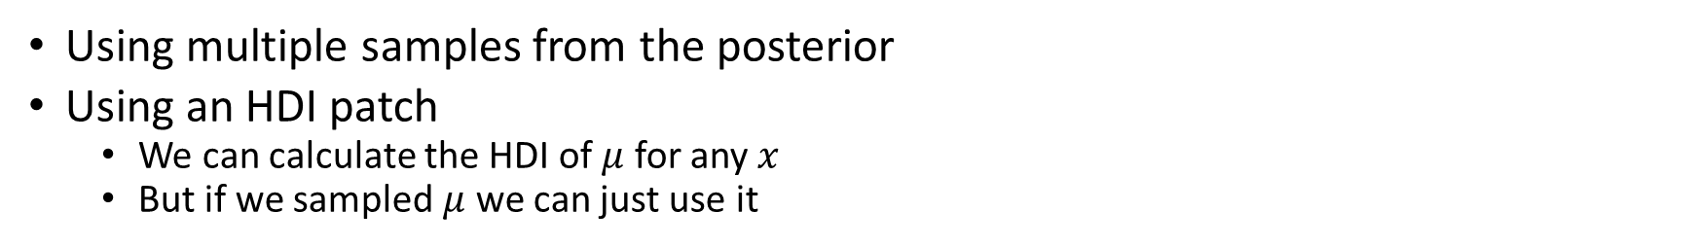
Showing the uncertainty
Using multiple samples from the posterior
Using an HDI patch
We can calculate the HDI of $μ$ for any $x$
But if we sampled $μ$ we can just use it
hdi_lines = az.hdi(idata_lb.posterior["μ"])
idx = np.argsort(bikes.temperature.values)
ax.fill_between(
bikes.temperature[idx],
hdi_lines["μ"][:, 0][idx],
hdi_lines["μ"][:, 1][idx],

Slide 19
Uncertainty in means and values
But also:
There is uncertainty:
In the mean
In the spread around the mean
In the specific values we would get
What value would be surprising to us?

Slide 20
6D Posterior Predictive Testing

Slide 21
How many bikes will actually be rented?
Posterior predictive sampling
MCMC samples of the posterior distribution of the parameters
Samples of posterior distributions calculated from the parameters
Data sampled given the posterior distributions of the parameters

Slide 22
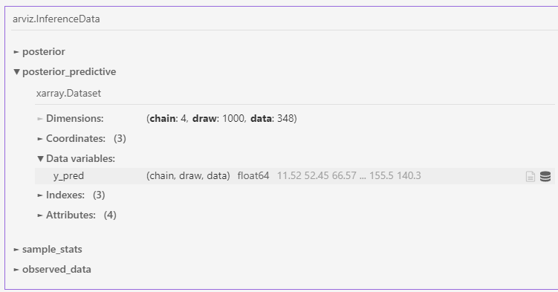
How many bikes will actually be rented?
Posterior predictive sampling
Practically
Sample from the posterior distribution of the parameters
Sample from the likelihood given these posterior samples
pm.sample_posterior_predictive(idata_lb, model=model_lb,
extend_inferencedata=True)

Slide 23
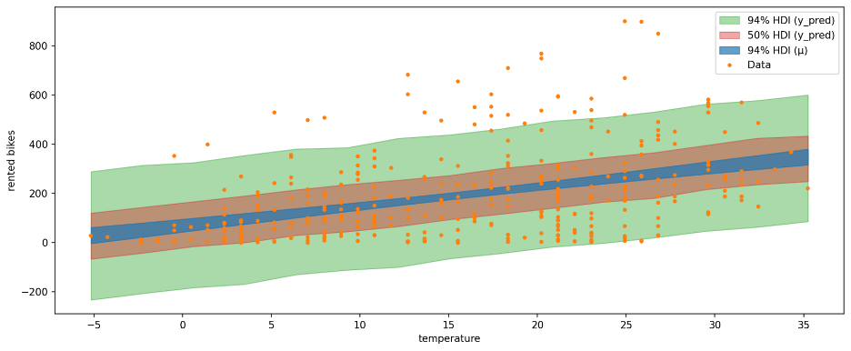
Showing the posterior predictive
Visualize uncertainty in both posterior mean and posterior predictive
Also show 2 different HDIs for posterior predictive

Slide 24
The posterior predictive is also a test
50% of the data should in the 50% posterior predictive HDI
Posterior predictive should not have empty areas

Slide 25
Posterior predictive testing
Bayesian p-values
P-values were invented by freqentists
And we’ll learn about them later
What percentage of posterior predictive values are less than actual data values?
For one posterior predictive dataset
Across posterior predictive datasets
is a probability distribution

Slide 26
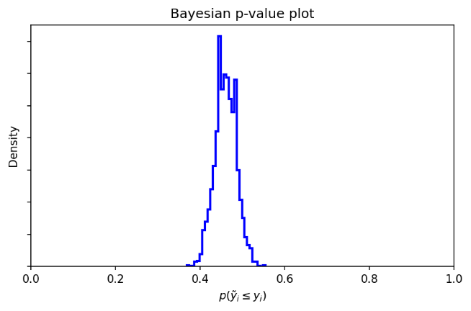
The distribution of Bayesian p values
Calculated for the bike data
This is a distribution over posterior predictive datasets

Slide 27

The theoretical Bayesian p value distribution
We want the distribution of $p_{B}$
Under the true model, we expect$p\left({\tilde{y}}_{i}≤y_{i}\right)=0.5$
The normalized binomial is nearly perfectly approximated by a Beta distribution. This is demonstrated in the notebook

Slide 28
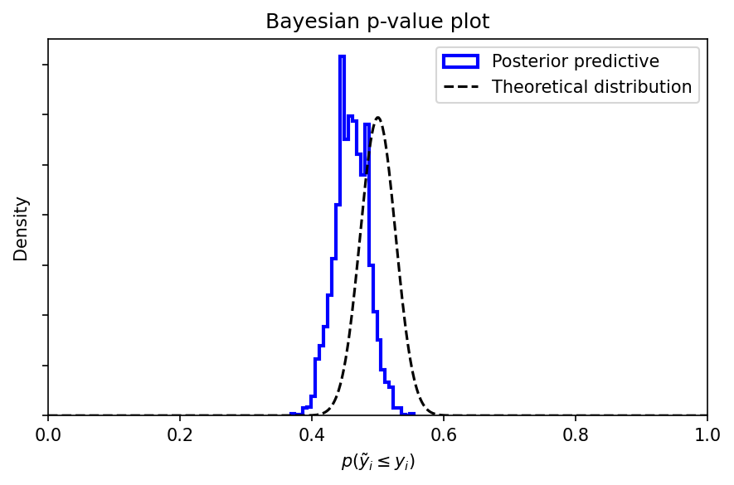
Compare empirical and theoretical distribution
Our bike rental data is not fit well by the model
Under the true model

Slide 29
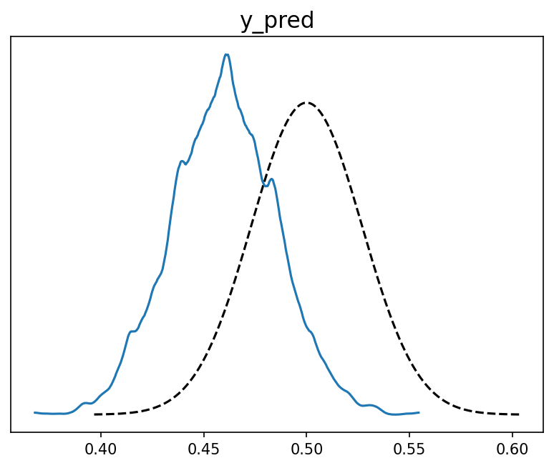
Arviz generates a smoothed version of this plot
az.plot_bpv(idata_lb, kind="p_value")

Slide 30
Comparing statistics
Instead of comparing value by value, compare a statistic that matters
Calculate a “statistic” from each posterior predictive dataset
Compare with statistic from observed dataset
Statistic:
Something we calculate on data
Mean
Median
Percentile
Standard deviation
Etc.

Slide 31
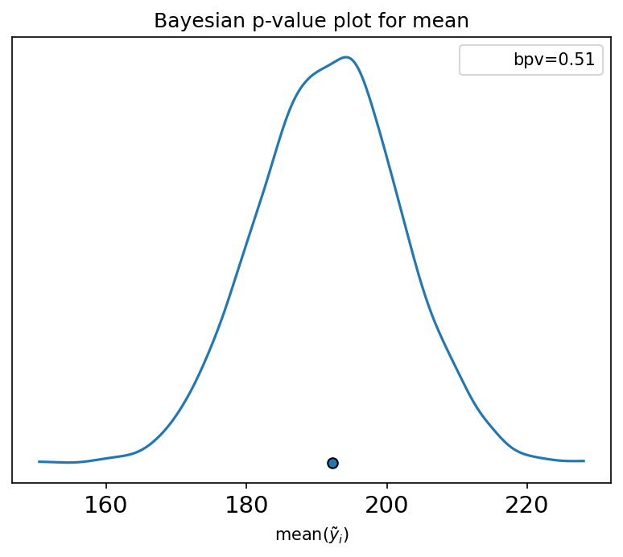
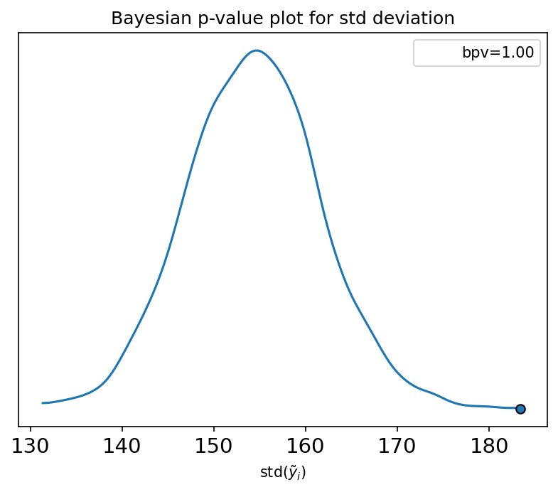
Posterior predictive mean and std for bike data
Dot shows value of statistic calculated on observed data
Our model captures the mean but not the width of the data

Slide 32
6E Bayesian workflow

Slide 33
Bayesian Workflow
Can we draw the steps?
Diagnostics
data
model
sample
Prior predictive
sample

Slide 34
Bayesian workflow
Diagnostics
Data
Model
Sample
Posterior
Inference
Posterior predictive sampling
Prior predictive sampling

Slide 35
The steps in the Bayesian workflow
Step | Test | Solutions
Data collection | Data validation procedures | Improve methodology Develop protocols Document processes
Propose model | Generate graph Take sample | Test dimensions Debug
Sample prior predictive | Prior predictive plots | Simplify model Change priors
Sample posterior | Trace plots Rhat ESS MCSE Divergences | Improve sampling Change initialization Reparameterize model Simplify model Change priors
Sample posterior predictive | Posterior predictive plots Bayesian p values | Change model

Slide 36
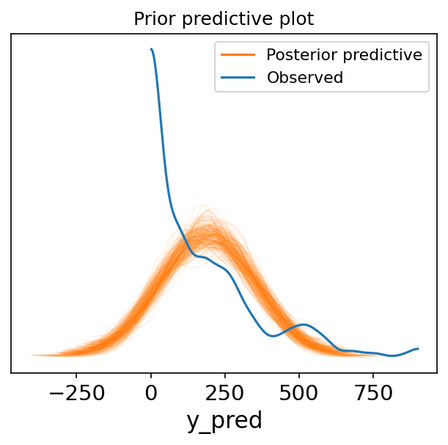
The posterior predictive plot
We can go back and do prior predictive checks
Or check the diagnostics

Slide 37
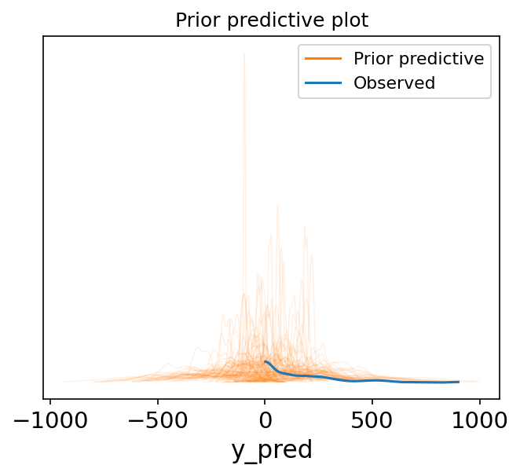
The prior predictive plot
The issue with negative bike rentals persists in the prior
Two possibilities:
Priors too loose
Likelihood wrong

Slide 38
6F Generalized Linear Models

Slide 39
Beyond the normal distribution: Generalized Linear Models
Normal Model
Generalized Linear Model
Gaussian likelihood
Linear prediction used directly
Parameterized likelihood
Linear prediction transformed

Slide 40
Generalized Linear Model for bike data
Normal Model
Negative Binomial Model
Gaussian likelihood
Linear prediction used directly
Negative binomial likelihood
Exponential link

Slide 41
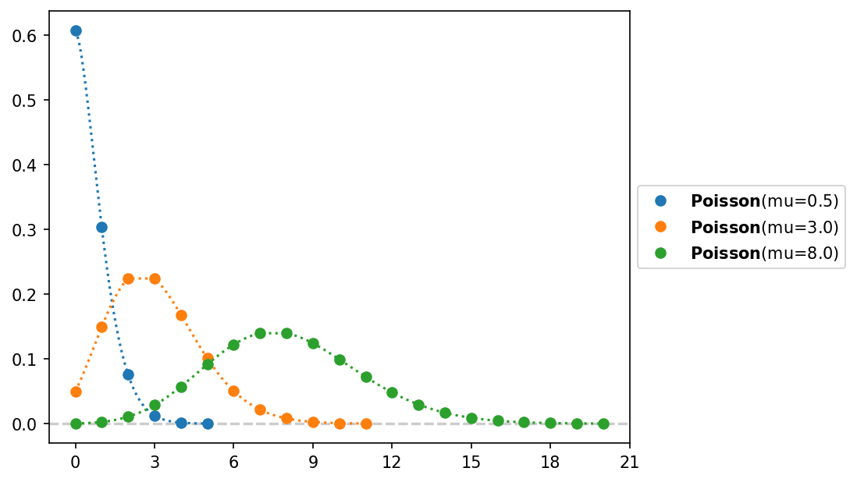
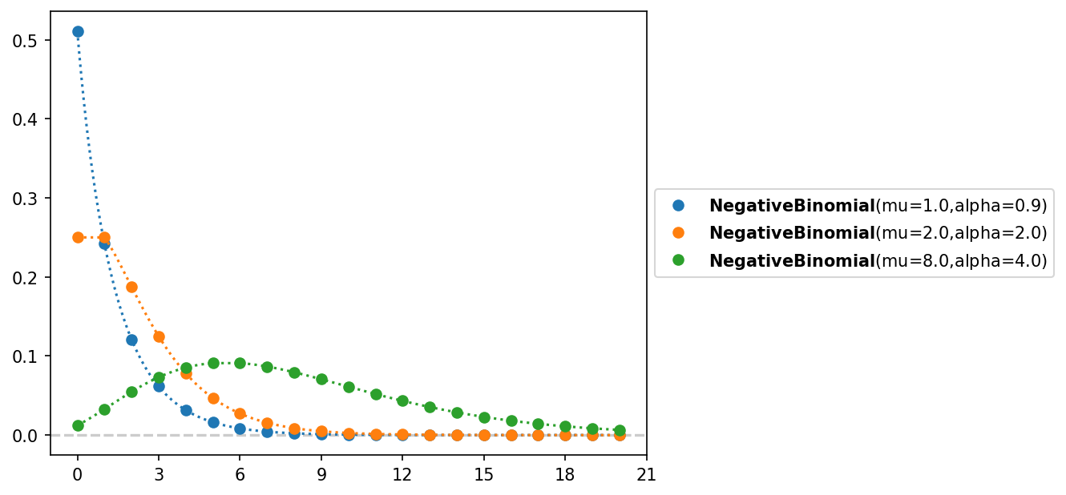
The Poisson and the negative binomial distributions
Both used for count data
Poisson distribution has only one parameter

Slide 42
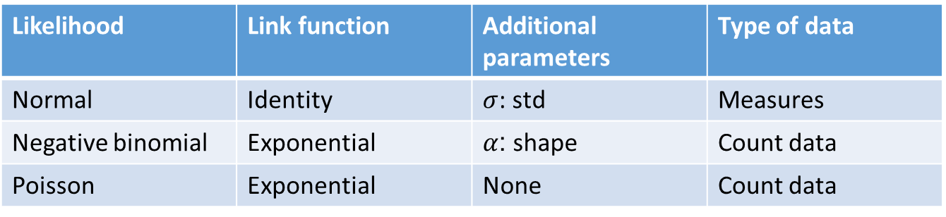
Building a GLM table
You can add to this or look it up
The full table has around 9 rows
Likelihood | Link function | Additional parameters | Type of data
Normal | Identity | $σ$: std | Measures
Negative binomial | Exponential | $α$: shape | Count data
Poisson | Exponential | None | Count data

Slide 43
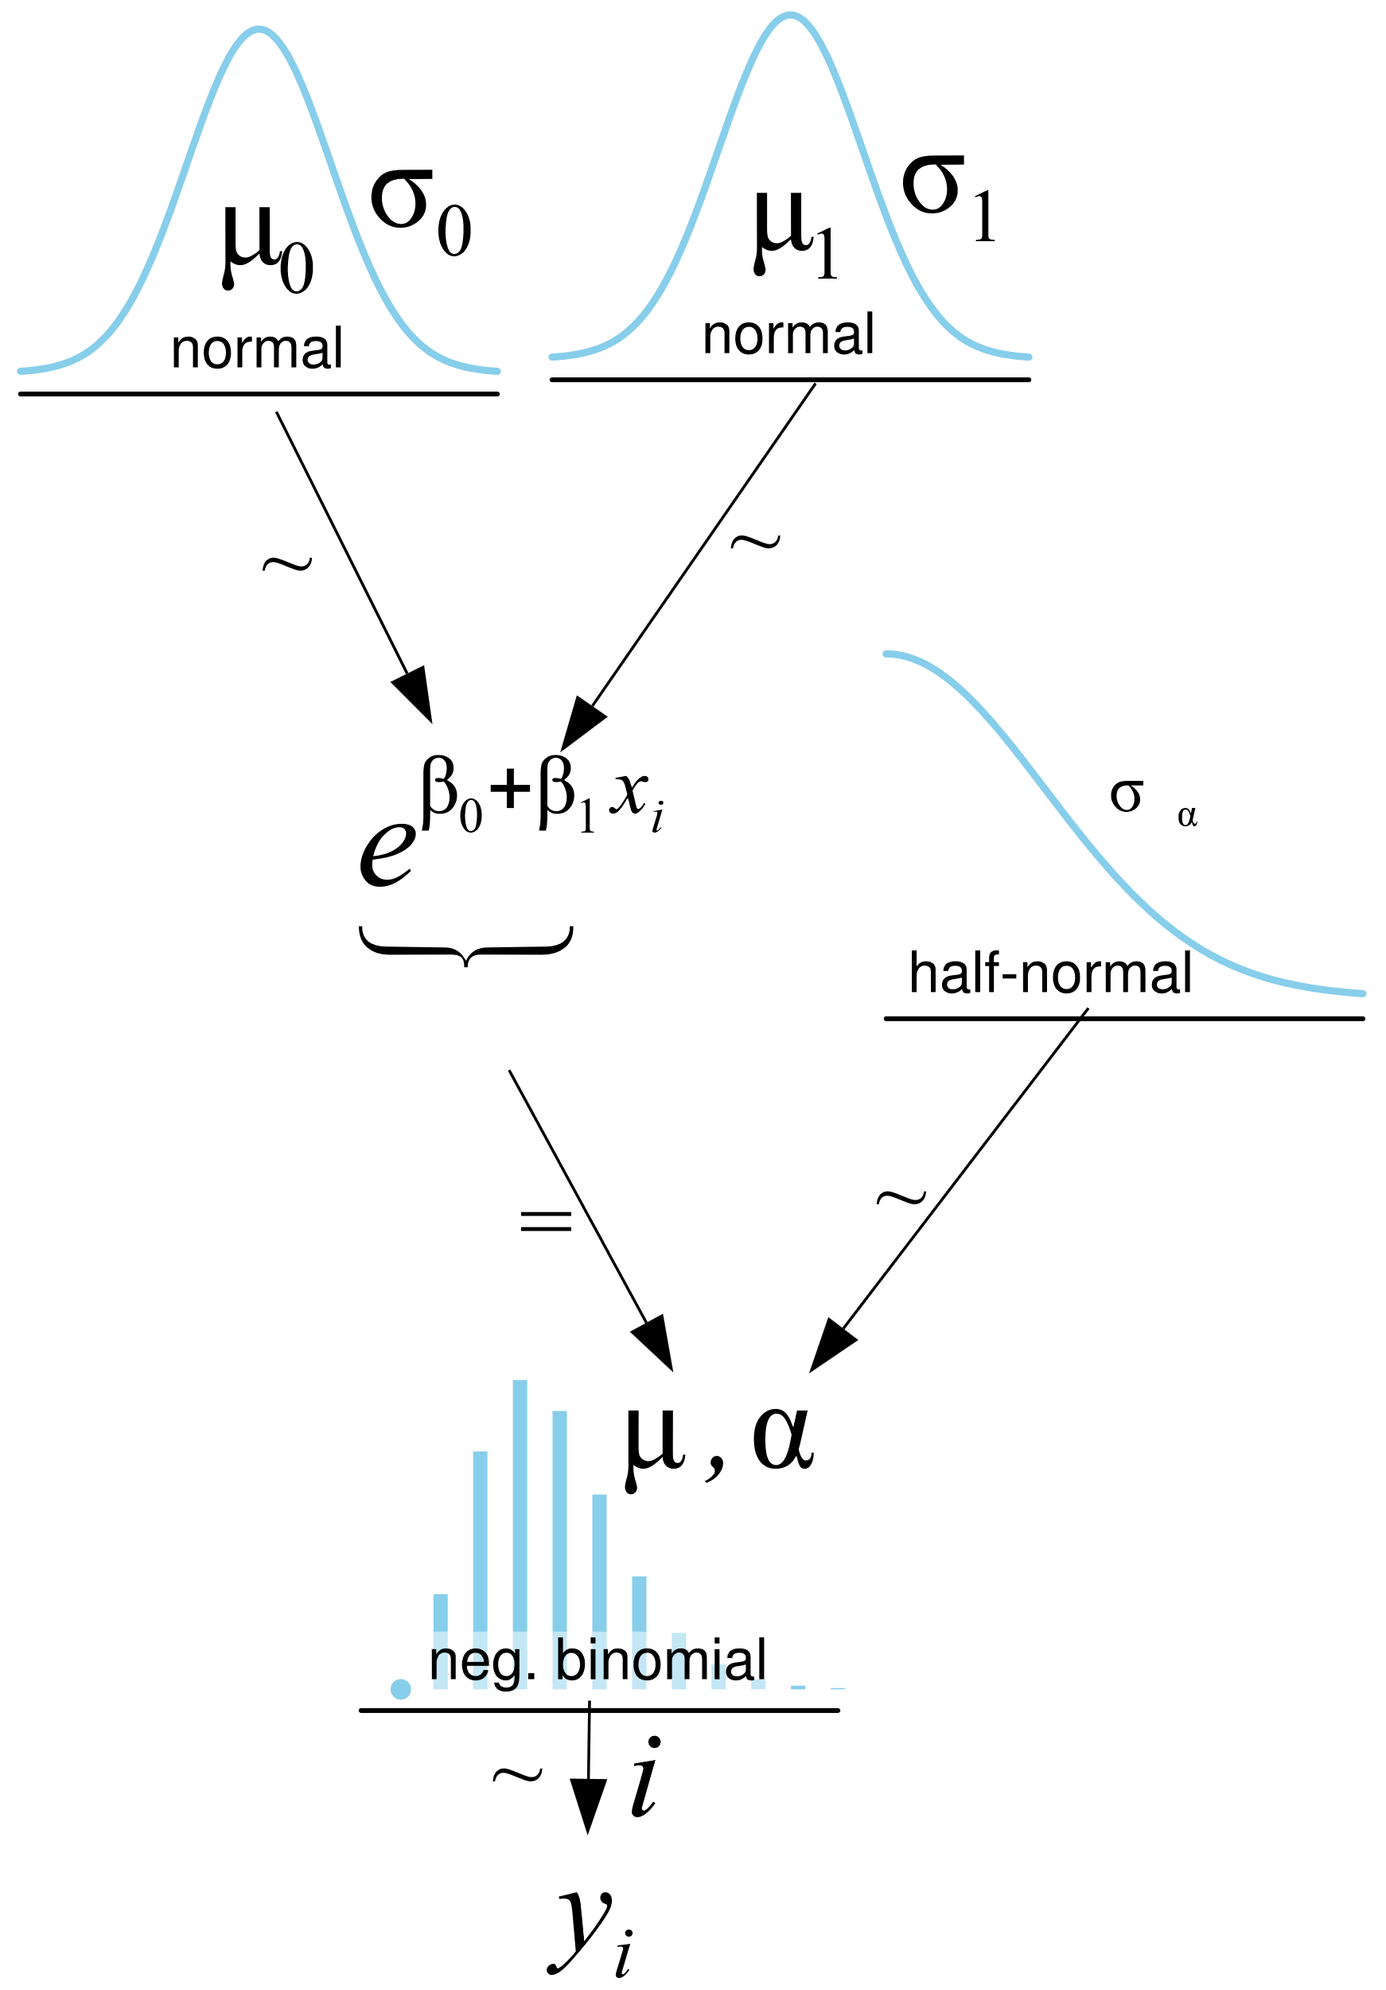
The negative-binomial model

Slide 44
The negative-binomial model
with pm.Model() as model_neg:
beta0 = pm.Normal("beta0", mu=mu_0, sigma=sigma_0)
beta1 = pm.Normal("beta1", mu=mu_1, sigma=sigma_1)
alpha = pm.HalfNormal("alpha", sigma=sigma_alpha)
mu = pm.Deterministic("mu",
pm.math.exp(beta0 + beta1 * bikes.temperature))
y_pred = pm.NegativeBinomial("y_pred", mu=mu, alpha=alpha,
observed=bikes.rented)

Slide 45
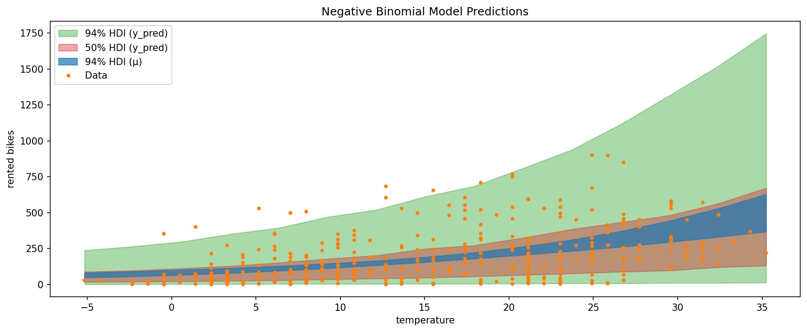

Slide 46
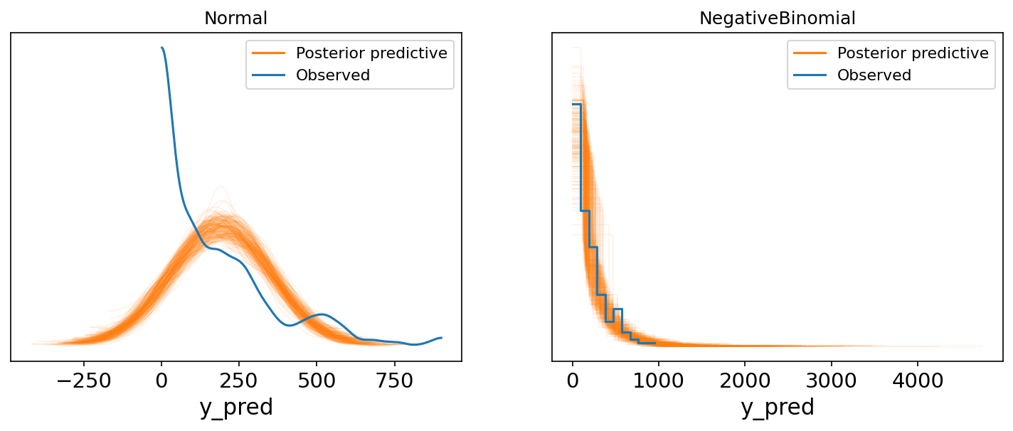
Posterior predictives comparison

Slide 47
6G Robust Regression

Slide 48
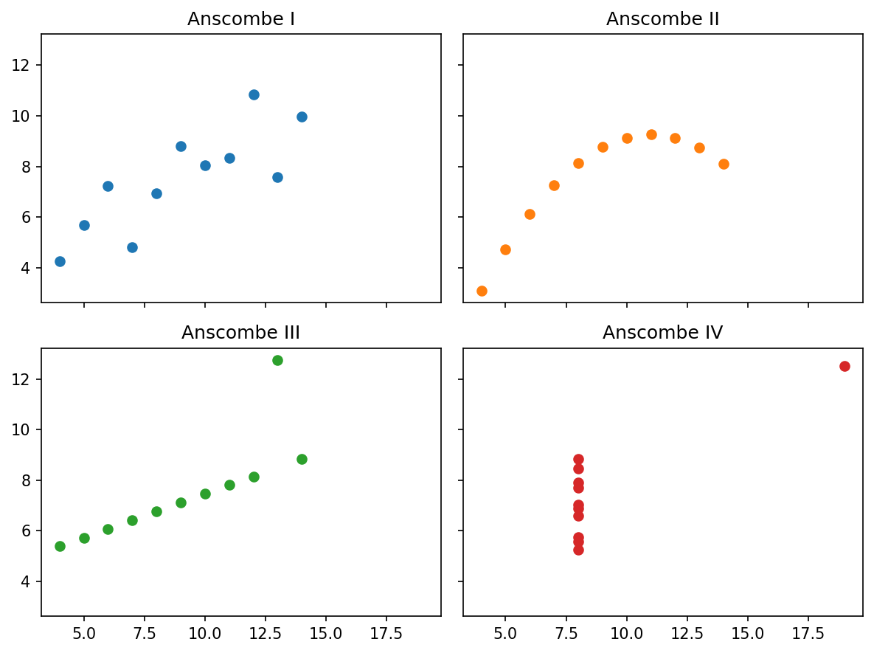
Anscombe’s quartet
Published in 1973
I: Gaussian regression data
Data that is appropriate for the model
II: Model mismatch
Data comes from a different model
III: Outlier
Data has one y very different
IV: Leverage
Data has one x very different

Slide 49
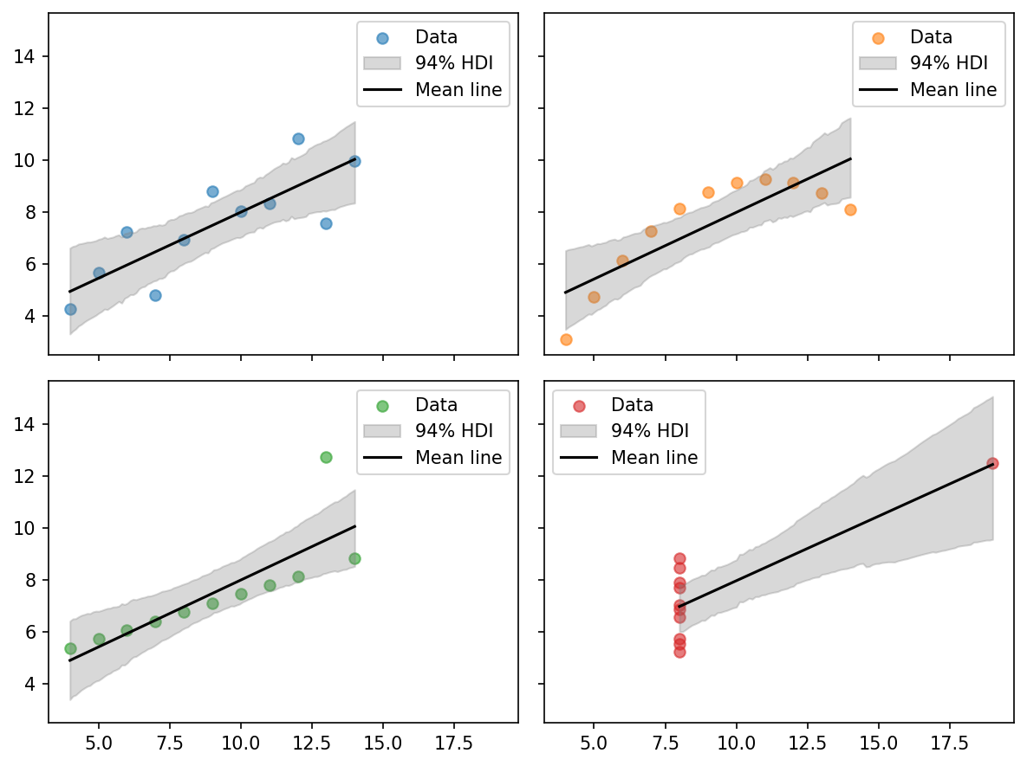
Linear regression on Anscombe
Linear model
Similar posterior for each dataset
The point:
Plot your data
Do your Bayesian workflow

Slide 50
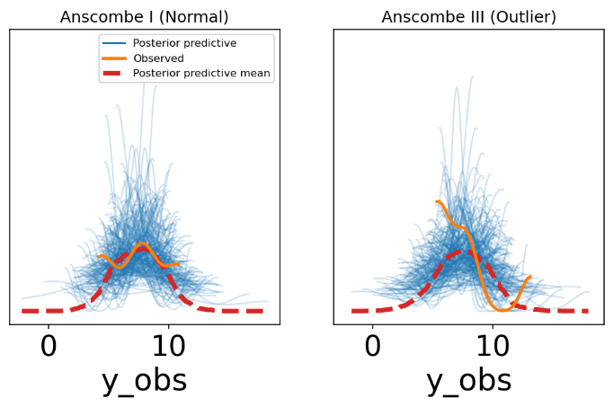
Examine posterior predictive
Quite broad around the data but barely sufficient to reach the outlier

Slide 51
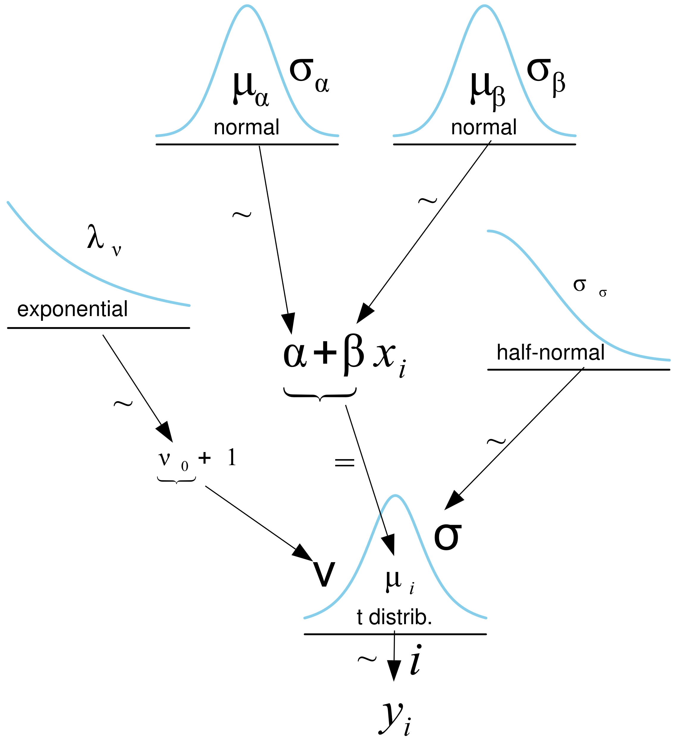

A student’s t likelihood can improve fit

Slide 52
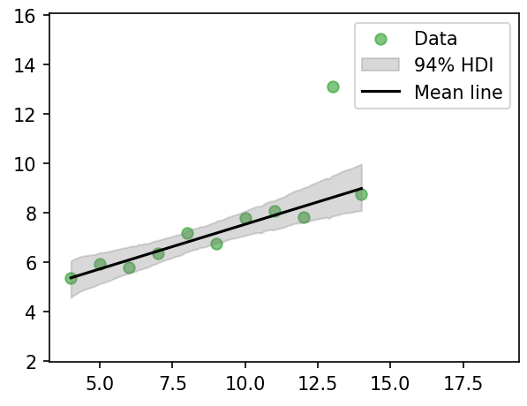
Fit improves using Student’s t
We learn model comparison in 2 more lectures

Slide 53
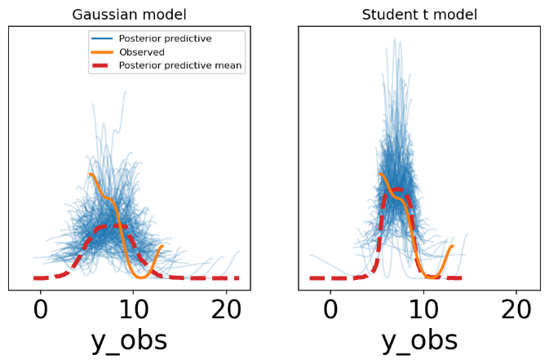
So does prior predictive
Is the asymmetry of the outlier meaningful?
Should we use an asymmetric likelihood?

Slide 54
6H Variable variance

Slide 55
Heteroskedsticity
Variance depends on the independent variable
Examples of heteroskedasticity in biomedical data
Heart rate variability increases with effort
People respond to effort differently
EMG noise increases with muscle activity
Larger muscle spindles recruited for larger activation
Flow cytometry cell counts
At low counts, stochastic fluctuations increase variance
qPCR (quantitative polymerase chain reaction) amplification
Low template levels amplify variability

Slide 56
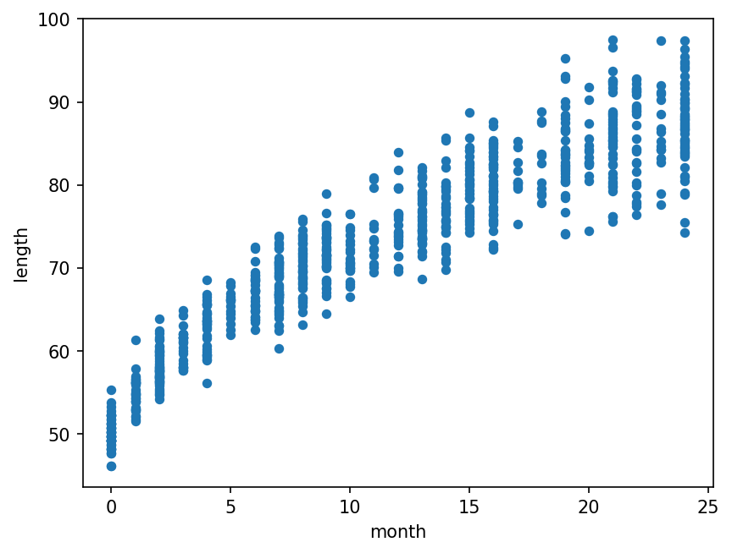
Baby growth chart
Collected by the WHO
Growth is not linear
Variance increases with age

Slide 57
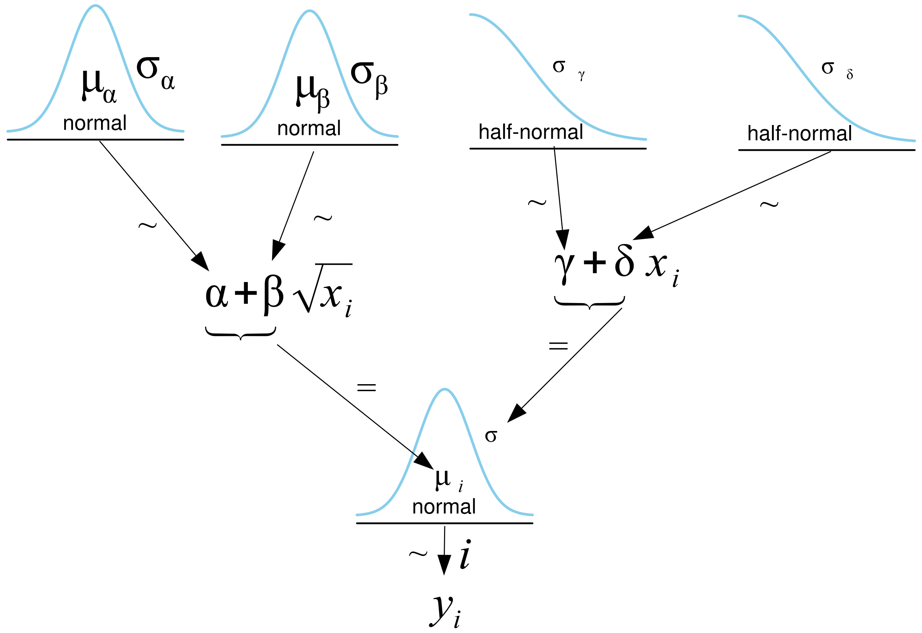
Baby growth chart: graphical model

Slide 58
Baby growth chart: code
coords = {"month": range(len(data.month))}
with pm.Model(coords=coords) as model_vv:
x_shared = pm.Data("x_shared", data.month.values.astype(float), dims=["month"])
α = pm.Normal("α", sigma=10)
β = pm.Normal("β", sigma=10)
γ = pm.HalfNormal("γ", sigma=10)
δ = pm.HalfNormal("δ", sigma=10)
μ = pm.Deterministic("μ", α + β * x_shared**0.5, dims=["month"])
σ = pm.Deterministic("σ", γ + δ * x_shared, dims=["month"])
y_pred = pm.Normal("y_pred", mu=μ, sigma=σ, observed=data.length, dims=["month"])

Slide 59
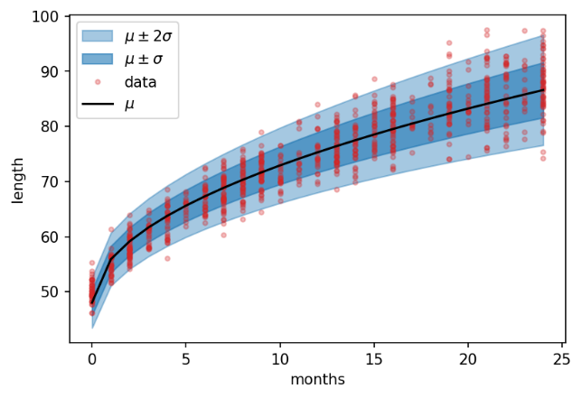
The variance expands to fit the data
μ_m = posterior["μ"].mean("sample").values
σ_m = posterior["σ"].mean("sample").values
ax.fill_between(data.month, μ_m + 2 * σ_m, μ_m - 2 * σ_m)
ax.fill_between(data.month, μ_m + 1 * σ_m, μ_m - 1 * σ_m)
ax.plot(data.month, data.length)
ax.plot(data.month, μ_m)

Slide 60
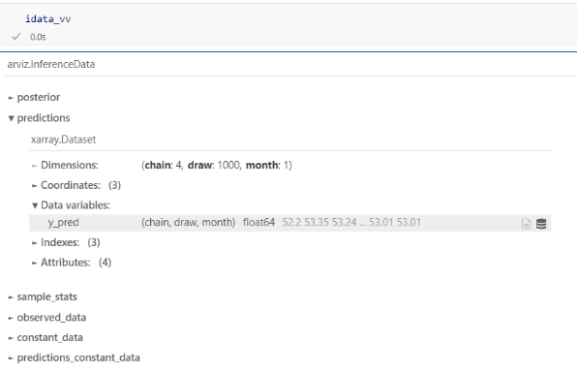
Predicting new data
What is the distribution of 2 week old babies?
with model_vv:
pm.set_data({"x_shared": [0.5]}, coords={"month": [0.5]})
ppc = pm.sample_posterior_predictive(idata_vv, var_names=['y_pred'], predictions=True, random_seed=123)

Slide 61
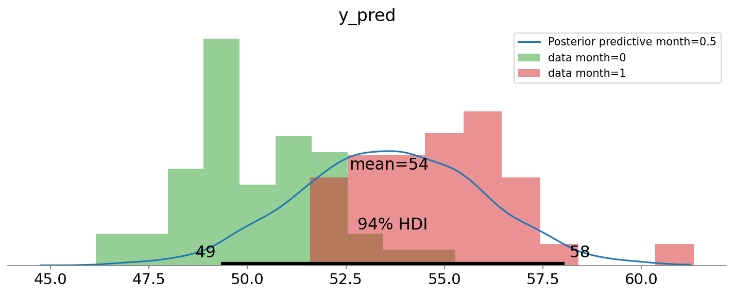
The prediction includes uncertainty
Compare posterior predictive with actual data

